Slide 1
Compound assignment operator +=
Heap
Stack
String s1 = "Hello ";
s1
AR main
‘H’
.
6
‘E’
storageM
length
‘L’
‘L’
‘0’
‘ ’

Slide 2
Compound assignment operator +=
Heap
Stack
String s1 = "Hello ";
String s2 = "World";
s1 += s2; OR
s1.operator+=(s2);
String& String::operator += (const String& s)
‘W’
‘O’
s2
‘R’
‘L’
s1
‘D’
‘\0’
.
5
AR main
‘H’
.
6
storageM
length
‘E’
storageM
length
‘L’
‘L’
‘0’
‘ ’

Slide 3
Compound assignment operator +=
Heap
Stack
String s1 = "Hello ";
String s2 = "World";
s1 += s2; OR
s1.operator+=(s2);
this
s
String& String::operator += (const String& s)
‘W’
‘O’
s2
‘R’
‘L’
s1
‘D’
‘\0’
.
5
AR main
‘H’
.
6
storageM
length
‘E’
storageM
length
‘L’
‘L’
‘0’
‘ ’

Slide 4
Compound assignment operator +=
Heap
Stack
String s1 = "Hello ";
String s2 = "World";
s1 += s2; OR
s1.operator+=(s2);
this
s
String& String::operator += (const String& s)
length += s.length;
‘W’
‘O’
s2
‘R’
‘L’
s1
‘D’
‘\0’
.
5
AR main
‘H’
.
11
storageM
length
‘E’
storageM
length
‘L’
‘L’
‘0’
‘ ’

Slide 5
Compound assignment operator +=
Heap
Stack
p
String s1 = "Hello ";
String s2 = "World";
s1 += s2; OR
s1.operator+=(s2);
.
12
storageM
length
this
s
String& String::operator += (const String& s)
length += s.length;
char *p = new char[length + 1];
‘W’
‘O’
s2
‘R’
‘L’
s1
‘D’
‘\0’
.
5
AR main
‘H’
.
11
storageM
length
‘E’
storageM
length
‘L’
‘L’
‘0’
‘ ’

Slide 6
Compound assignment operator +=
Heap
Stack
p
String s1 = "Hello ";
String s2 = "World";
s1 += s2; OR
s1.operator+=(s2);
‘H’
.
12
‘E’
storageM
length
‘L’
this
s
‘L’
‘0’
‘ ’
String& String::operator += (const String& s)
length += s.length;
char *p = new char[length + 1];
assert(p != 0);
strcpy(p, storageM);
‘W’
‘O’
s2
‘R’
‘L’
s1
‘D’
‘\0’
.
5
AR main
‘H’
.
11
storageM
length
‘E’
storageM
length
‘L’
‘L’
‘0’
‘ ’

Slide 7
Compound assignment operator +=
Heap
Stack
‘H’
p
String s1 = "Hello ";
String s2 = "World";
s1 += s2; OR
s1.operator+=(s2);
‘E’
‘L’
.
12
‘L’
‘0’
storageM
length
‘ ’
this
s
‘W’
‘O’
‘R’
‘L’
‘D’
String& String::operator += (const String& s)
length += s.length;
char *p = new char[length + 1];
assert(p != 0);
strcpy(p, storageM);
strcat(p, s.storageM);
‘\0’
‘W’
‘O’
s2
‘R’
‘L’
s1
‘D’
‘\0’
.
5
AR main
‘H’
.
11
storageM
length
‘E’
storageM
length
‘L’
‘L’
‘0’
‘ ’

Slide 8
Compound assignment operator +=
Heap
Stack
‘H’
p
String s1 = "Hello ";
String s2 = "World";
s1 += s2; OR
s1.operator+=(s2);
‘E’
‘L’
.
12
‘L’
‘0’
storageM
length
‘ ’
this
s
‘W’
‘O’
‘R’
‘L’
‘D’
String& String::operator += (const String& s)
length += s.length;
char *p = new char[length + 1];
assert(p != 0);
strcpy(p, storageM);
strcat(p, s.storageM);
delete storageM;
‘\0’
‘W’
‘O’
s2
‘R’
‘L’
s1
‘D’
‘\0’
.
5
AR main
.
11
storageM
length
storageM
length

Slide 9
Compound assignment operator +=
Heap
Stack
‘H’
p
String s1 = "Hello ";
String s2 = "World";
s1 += s2; OR
s1.operator+=(s2);
‘E’
‘L’
.
12
‘L’
‘0’
storageM
length
‘ ’
this
s
‘W’
‘O’
‘R’
‘L’
‘D’
String& String::operator += (const String& s)
length += s.length;
char *p = new char[length + 1];
assert(p != 0);
strcpy(p, storageM);
strcat(p, s.storageM);
delete storageM;
storageM = p;
‘\0’
‘W’
‘O’
s2
‘R’
‘L’
s1
‘D’
‘\0’
.
5
AR main
.
11
storageM
length
storageM
length

Slide 10
Compound assignment operator +=
Heap
Stack
‘H’
p
String s1 = "Hello ";
String s2 = "World";
s1 += s2; OR
s1.operator+=(s2);
‘E’
‘L’
.
12
‘L’
‘0’
storageM
length
‘ ’
this
s
‘W’
‘O’
‘R’
‘L’
‘D’
String& String::operator += (const String& s)
length += s.length;
char *p = new char[length + 1];
assert(p != 0);
strcpy(p, storageM);
strcat(p, s.storageM);
delete storageM;
storageM = p;
‘\0’
‘W’
‘O’
s2
‘R’
‘L’
s1
‘D’
‘\0’
.
5
AR main
.
11
storageM
length
storageM
length

Slide 11
Compound assignment operator +=
Heap
‘H’
String s1 = "Hello ";
String s2 = "World";
s1 += s2; OR
s1.operator+=(s2);
‘E’
‘L’
‘L’
‘0’
‘ ’
‘W’
‘O’
‘R’
‘L’
‘D’
String& String::operator += (const String& s)
length += s.length;
char *p = new char[length + 1];
assert(p != 0);
strcpy(p, storageM);
strcat(p, s.storageM);
delete storageM;
storageM = p;
return *this;
‘\0’
‘W’
‘O’
s2
‘R’
‘L’
s1
‘D’
‘\0’
.
5
AR main
.
12
storageM
length
storageM
length

Slide 12
Why do we need the << operator for the String class?
String s = "Hello";
std::cout << s;
Notes:
The << operator is typically overloaded to allow the object (in this case, a String object) to be printed using an output stream like std::cout. For example:

Slide 13
What type of object is on the left side of the operator <<?
std::cout << s;
Notes:
The left side of the << operator is typically an output stream object like std::ostream. For example, in:
std::cout is the object on the left side.

Slide 14
What type of object is on the right side of the operator <<?
std::cout << s;
Notes:
The right side of the << operator is the object being output, in this case, a String object. For example, in:
s is the object on the right side, which is a String object.

Slide 15
What type of object should be returned from the << operator function?
std::cout << s1 << s2;
Notes:
The << operator should return a reference to the output stream (std::ostream&). This allows chaining of the << operator, such as:

Slide 16
Should this overloaded operator function be a member of the String class?
Not be a member function of the String class,
A non-member function or a friend function.
Notes:
The << operator should not be a member function of the String class because the left-hand operand (std::ostream) is not a String object. Instead, it should be a non-member function or a friend function if it needs access to private data members of the String class.

Slide 17
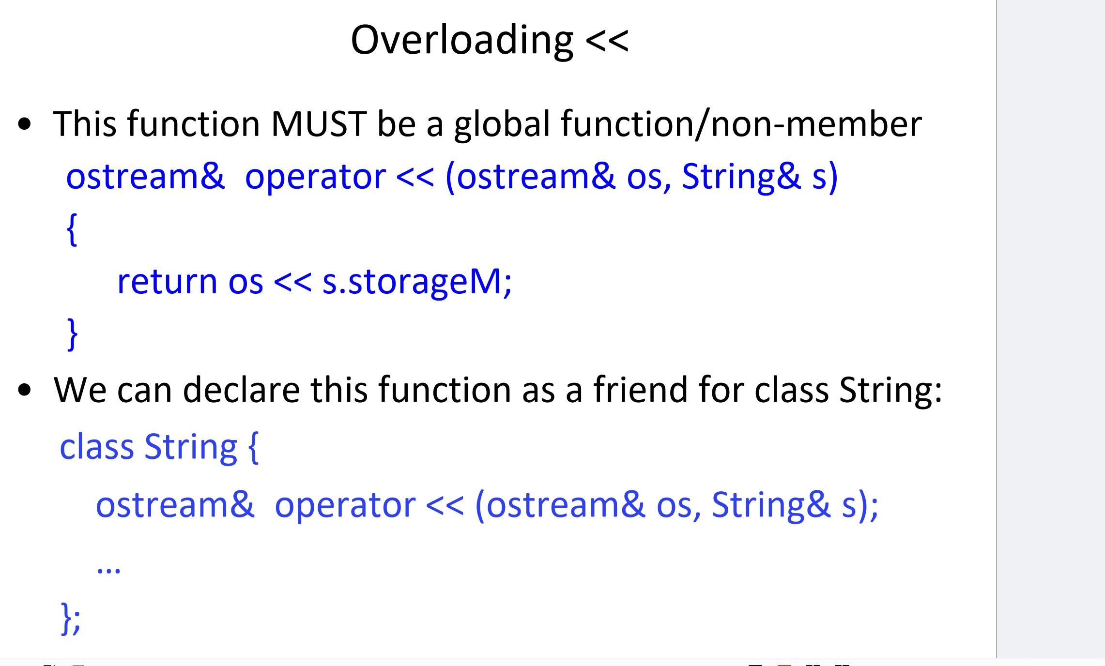
String s("Hello");
std::cout << s;
class String {
friend ostream& operator << (ostream& os, String& s);
// other members of the class...
};
Notes:
ostream& means this function returns a reference to the output stream (like std::cout). The << operator must be a global function or a non-member function because the first argument (on the left side of <<) is not a String object—it is an output stream (like std::cout), which is not part of the String class. The String object (s) is on the right side of the operator. std::cout << s1 << s2;
ostream& os: A reference to an output stream (such as std::cout).
String& s: A reference to a String object, which we want to print.
ostream& os: This is the output stream, like std::cout. It’s where we want to send the output (e.g., to the console).String& s: This is our custom String object (the one we want to print)
return os << s.storageM;
String s("Hello World");
std::cout << s;

Slide 18
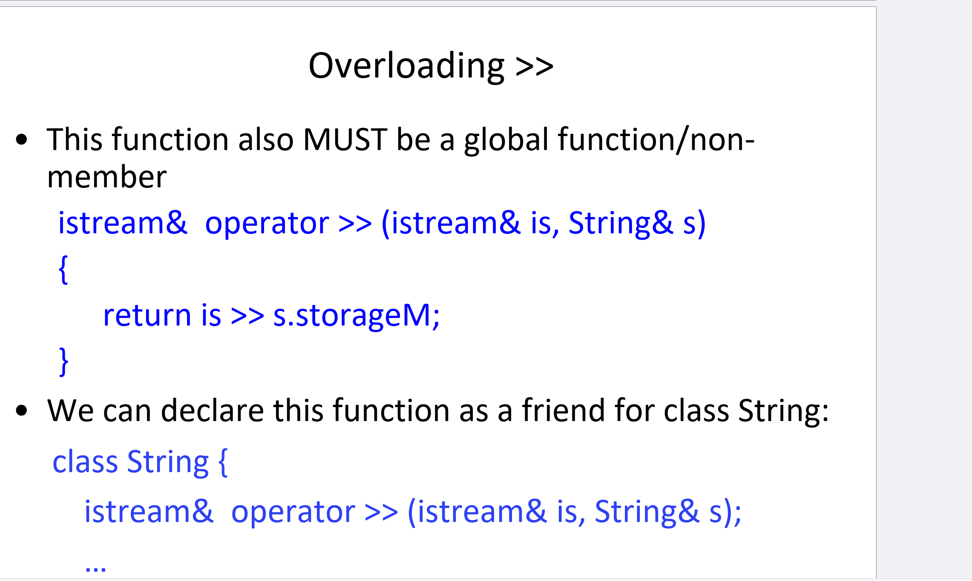
String s1; // Create a String object
// Input a string into s1
cout << "Enter your name: ";
cin >> s1; // User types "Alice"
// Output the string stored in s1
cout << "Your name is: " << s1
class String {
friend istream& operator >> (istream& is, String& s);
// other members of the class...
};
Notes:
This function allows the >> operator (like cin >> s) to be used with a custom String class, so you can input a string directly into a String object from an input stream (such as cin
istream& is: This is a reference to the input stream, such as cin.
String& s: This is a reference to a String object where the input will be stored.
s.storageM: This is the member of the String class where the string data is stored (like a character array or C-style string).
The user types "Alice".cin >> s1; calls the overloaded >> operator, which reads "Alice" from the input stream (cin) and stores it in s1.storageM.The cout << s1; statement calls the overloaded << operator, which accesses s1.storageM and prints "Alice" to the console.

Slide 19
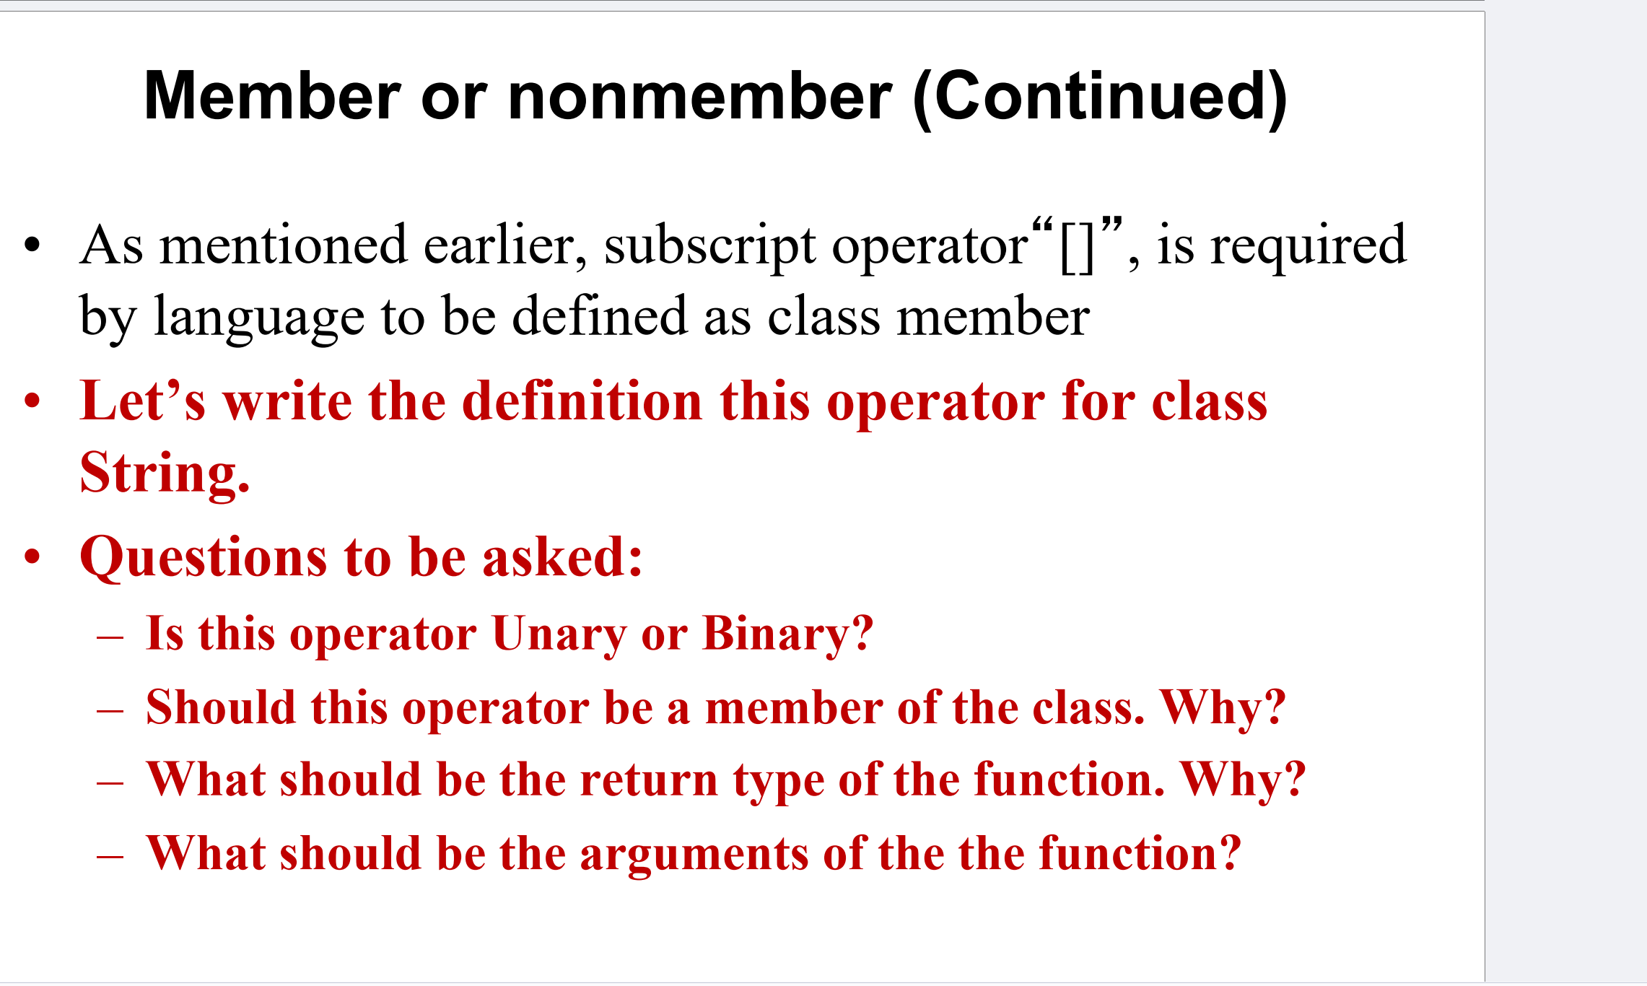

Slide 20
Is this operator Unary or Binary?
s[3]
Notes:
The subscript operator ([]) is a binary operator because it operates on two operands:The object itself (on which the operator is applied).
The index inside the square brackets (e.g., s[3], where 3 is the second operand).

Slide 21
Should this operator be a member of the class?
Directly accesses the internal data of the class
Notes:
It directly accesses the internal data of the class, and only member functions have access to the private members of the class (such as the internal character array).

Slide 22
What should be the return type of the function? Why?
s[0] = 'A'; // Modify the first character of the string
Notes:
The return type should be a reference to a char (if you’re working with characters in a string).char& for non-const objects (to allow modification).
const char& for const objects (to ensure immutability).
Why?: By returning a reference, the user can both read and modify the characters of the string using the subscript operator, like this:

Slide 23
What should be the arguments of the function?
index (typically an int or size_t)
Notes:
The argument should be the index (typically an int or size_t) that specifies which element to access inside the string.For example, s[3] would pass 3 as the index to the function.

Slide 24
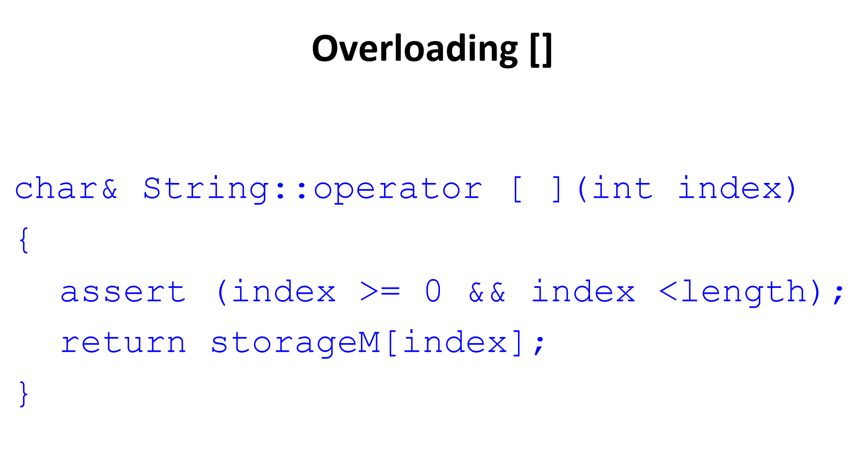
String s("Hello"); // Create a String object initialized with "Hello"
cout << s[0];
s.storageM points to the character array {'H', 'e', 'l', 'l', 'o', '\0'}
Notes:
Return Type (char&):
This returns a reference to the character at the specified index. The char& return type allows the character to be both read and modified.
Parameter (int index):
The parameter index is the position in the string that you want to access. The [] operator will return the character at this position.
Assertions (assert(index >= 0 && index < length)):
The assert statement ensures that the index is within the valid range of the string (i.e., greater than or equal to 0 and less than the total length of the string).
If the index is out of range, the program will terminate with an assertion failure.
Return Statement (return storageM[index]):
storageM is the internal character array where the string data is stored.
The function returns a reference to the character at position index in storageM.

Slide 25
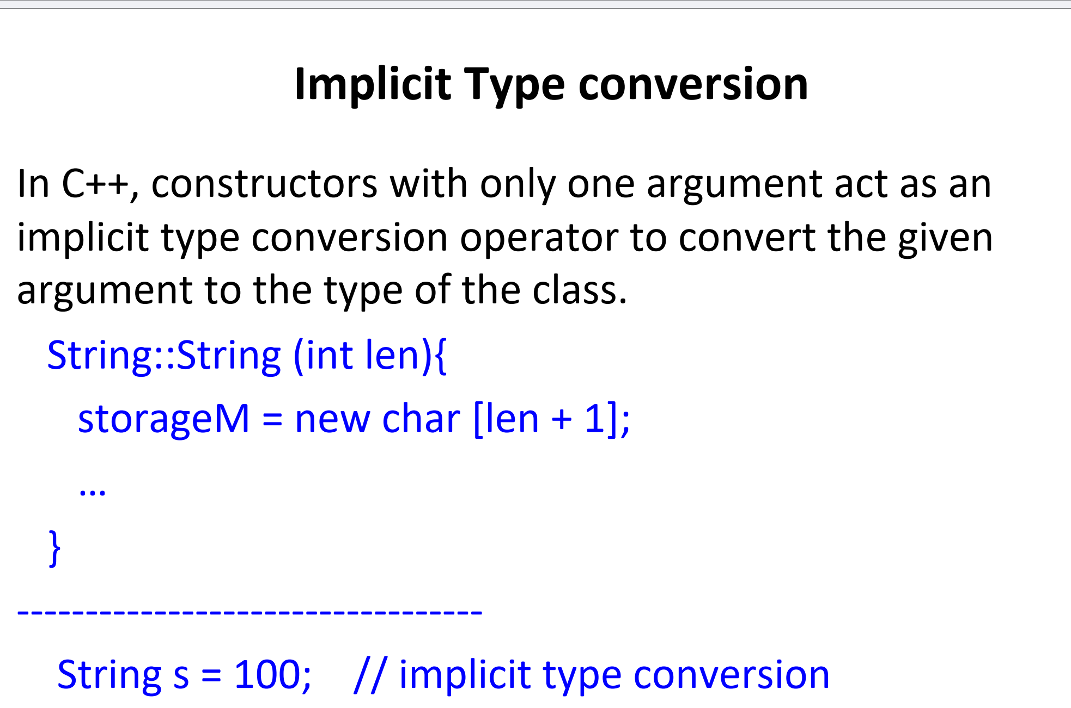
Notes:
Implicit type conversion in C++ (sometimes called "type coercion") is a feature that helps improve code readability and convenience by automatically converting one data type into another when needed. This feature is used when it makes sense for the program to perform conversions without explicitly stating them, allowing the code to be simpler and cleaner.
In C++, when you define a constructor that takes a single argument, it can be used by the compiler to automatically convert the argument's type to the type of the class. This is known as implicit type conversion.
This constructor takes a single integer argument len and creates a new String object with space for len + 1 characters (including the null terminator '\0' for C-style strings).
Step 1: The compiler sees String s = 100; and notices that 100 is an integer, but s is of type String. Step 2: The compiler looks for a constructor in the String class that can accept an int. It finds the String::String(int len) constructor. Step 3: The compiler calls String::String(100), passing 100 as the len argument, which creates a String object with space for 100 + 1 characters.Step 4: s is now a valid String object initialized with that memory.

Slide 26
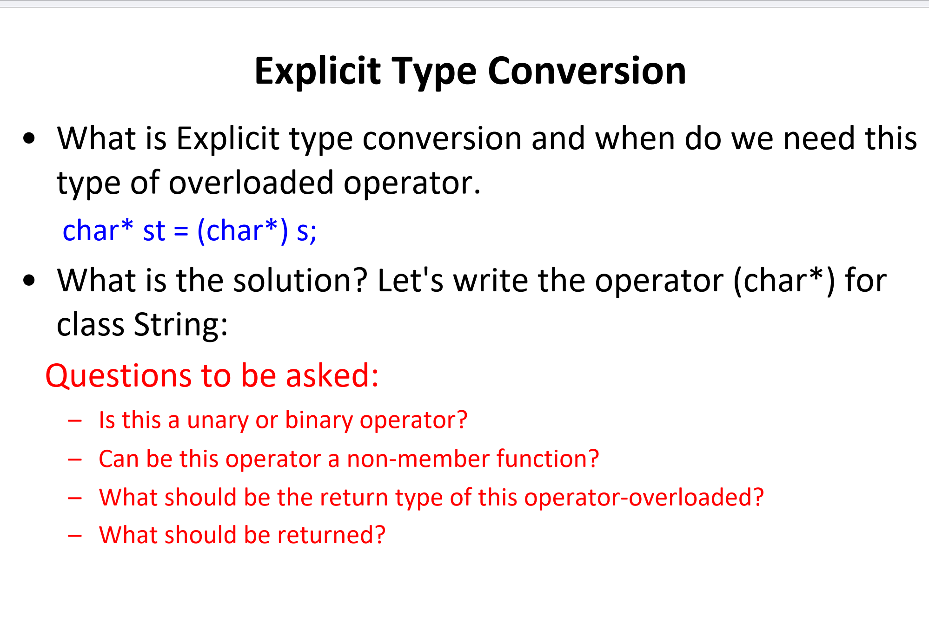
Notes:
Explicit type conversion (also called type casting) is when you manually convert one data type to another. This is done in C++ using cast syntax, for example:
Here, the String object s is explicitly cast to a char*. This is not an automatic conversion; you are forcing the program to treat the String object as a char* (pointer to a character array).
Why Do We Need Explicit Conversion?
Sometimes, you want to convert a custom class type (like String) into a built-in type (like char*). This is useful when you need access to the internal data of a class that isn't exposed directly.
In this case, the String class contains the character data inside storageM (a char array). To access that data directly as a char*, you need to overload the explicit conversion operator for char*.
In some cases, implicit conversions (automatic) are not appropriate because they could lead to unexpected behavior or bugs. By using explicit conversion, you ensure that the conversion only happens when it is explicitly intended by the programmer.
For example, you would not want a String object to automatically convert into a char* every time it’s used. But when you explicitly cast (char*) s, it’s clear that you are asking the compiler to convert the String to a char* intentionally.

Slide 27
Questions to Consider:
Is this a unary or binary operator?
Unary operator
Can this operator be a non-member function?
No
What should be the return type of this operator-overloaded?
What should be returned?
Notes:
This is a unary operator because it operates on only one operand (the object that is being cast).
No. This operator needs access to the internal data (storageM) of the class. It must be a member function to access private members of the class.
The return type should be a char* because the goal is to convert the String object into a char* pointer to the internal character array.
The operator should return the internal storageM array, which holds the string data.

Slide 28
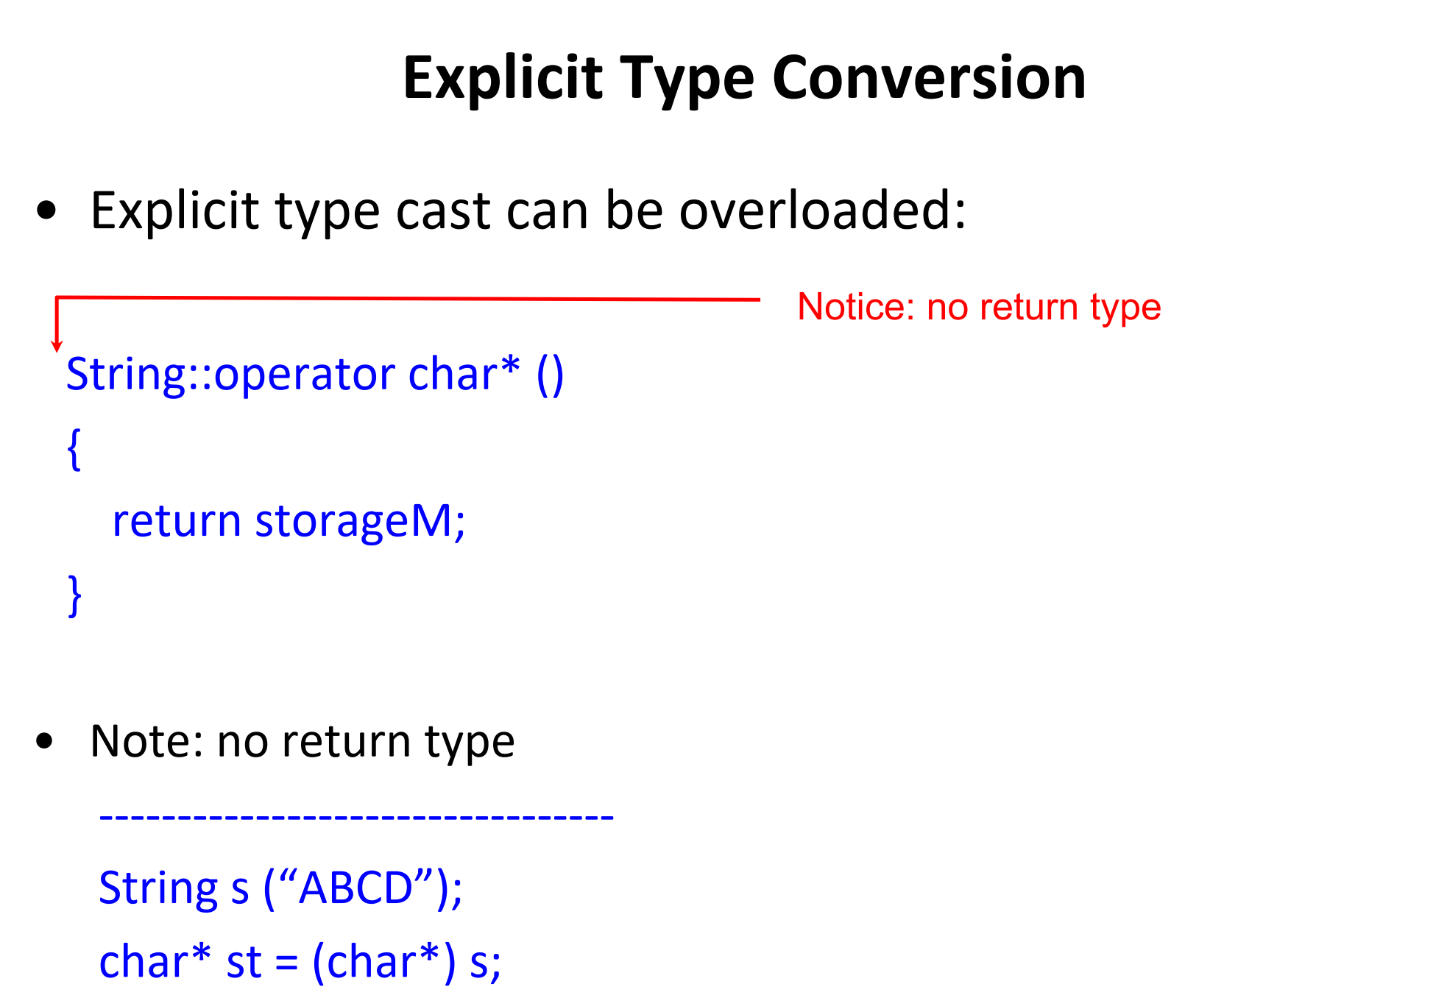
operator int() {
return 42;
}
Notes:
No Return Type Specified:
Notice that there is no explicit return type in this function definition. This is because, in C++, when overloading the cast operator, the return type is implicitly understood from the operator being overloaded.
Here, we are overloading the cast operator for char*, so the return type is implicitly char*.
he purpose of this overloaded operator is to allow an object of type String to be explicitly cast into a char*. This allows access to the internal character array (storageM) that holds the string data.
String s("ABCD");
A String object s is created, and "ABCD" is stored in s.storageM.
char st = (char) s;**
The object s is explicitly cast to a char* using (char*) s.
This triggers the overloaded cast operator operator char*() in the String class.
The cast operator returns the internal character array storageM, which contains "ABCD".
As a result, st now points to the string "ABCD".

Slide 29
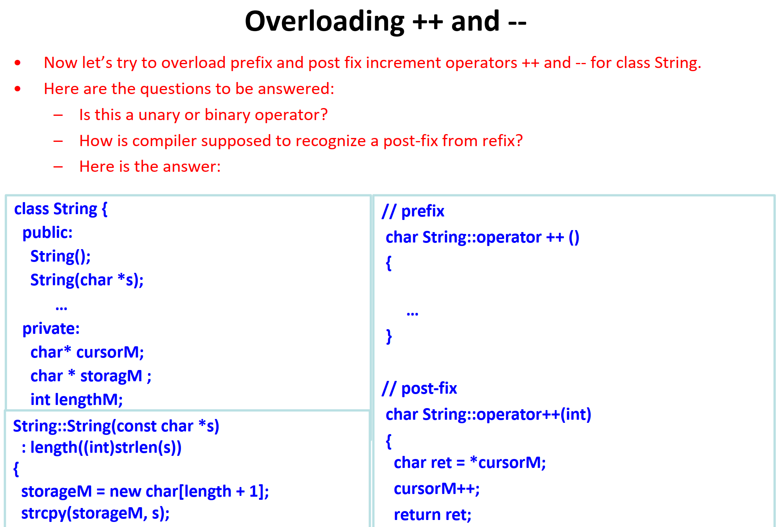
Notes:
The ++ and -- operators are unary operators when used in this context, as they operate on a single object, such as incrementing or decrementing a variable.

Slide 30
String s("Hello World");
++s
// Logic for prefix increment
cursorM++; // Move the cursor to the next character
return *cursorM;}
cursorM = storageM;
Notes:
How Does the Compiler Recognize Prefix and Postfix?
The compiler distinguishes between prefix and postfix versions of the ++ or -- operators by looking at the function signature:
Prefix version: Has no parameters.
Postfix version: Takes an int as a dummy parameter. This is how the compiler knows it's the postfix version, even though the parameter isn't used for any logic.

